Slide 1


Analysis and Design of Algorithms
Transform Coding
Chapter 2: Fundamentals of the Analysis of Algorithm Efficiency
School of Software Engineering © Ye Luo

Slide 2
Fundamentals of the Analysis of Algorithm Efficiency
Algorithm analysis framework
Asymptotic notations
Analysis of non-recursive algorithms
Analysis of recursive algorithms
Since there are often many possible algorithms or programs that compute the same results, we would like to use the one that is fastest.
· How do we decide how fast an algorithm is? Since knowing how fast an algorithm runs for a certain input does not reveal anything about how fast it runs on other inputs, we need another measure that tells us how fast it is for any input. A formula that relates input size to the running time of the algorithm satisfies this requirement.
· We also want to ignore machine dependent factors. If an algorithm takes two seconds on one machine for a given input, a trivial way to get it to run in one second is to use a machine that is twice as fast. There is a constant multiplicative factor relating the speed of an algorithm on one machine and its speed on another, which we will ignore.
· We are only interested in how fast an algorithm runs on large inputs, since even slow algorithms finish quickly on small inputs.
Notes:
教学内容
�算法效率分析框架
�算法效率的渐进性表示
�非递归算法的效率分析
�递归算法的效率分析

Slide 3
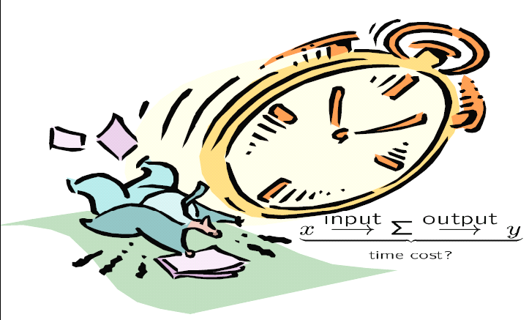
Analysis of Algorithms
Analysis of algorithms means to investigate an algorithm’s efficiency with respect to resources: running time and memory space.
With respect to input size, input type, and algorithm function
C=F(N, I, A)
Time efficiency T(N, I):
how fast an algorithm runs.
Space efficiency S(N , I):
the space an algorithm requires.
Notes:
-----
计算机模型的假设
计算机形式理论模型： Turing机模型
通用计算机模型：
顺序计算机
有足够的“内存”
能在固定的时间内存取数据单元
------
算法复杂性= 算法的效率＝算法所需要的计算机资源
两大方面的资源：空间与时间
算法分析是对一个算法需要多少计算时间和存储空间作定量的分析。
时间效率：对于所有的算法，对于规模更大的输入都需要运行更长的时间
空间效率
------
如何进行算法分析？
对算法进行全面分析，可分两个阶段进行：
事前分析：求算法的一个时间/空间限界函数，即通过对算法的“理论”分析，得出关于算法时间和空间特性的特征函数（Ο、Ω）——与计算机物理软硬件没有直接关系。
事后测试：将算法编制成程序后实际放到计算机上运行，
收集其执行时间和空间占用等统计资料，进行分析判断——直接与物理实现有关。
事后测试：目的：运行程序，统计执行实际耗费的准确的时间与空间，与事前分析的结论进行比较，验证先前的分析结论——包括正确性、执行性能等，比较、优化所设计的算法。
分析手段：作时、空性能分布图
----------------------------------------------------<计算机算法基础>
我们这里主要关注事前分析，
分析算法的目的在于：通过对算法的分析，在把算法变成程序实际运行前，就知道为完成一项任务所设计的算法的好坏，从而运行好的算法，改进差的算法，避免无益的人力和物力浪费。
------
算法的时间效率和空间效率都用输入规模的函数进行度量。
Input size:问题的规模（输入大小）。

Slide 4
Analysis of Algorithms
Analysis Framework
Measuring running time
Measuring an input’s size
Orders of growth (of the algorithm’s efficiency function)
Worst-case, best-case and average-case efficiency

Slide 5
Analysis of Algorithms
Units for Measuring Running Time
Should we measure the running time using standard unit of time measurements, such as seconds, minutes?
    Depends on the speed of the computer
    Depends on the quality of programing
Count the number of times each element operation is executed.
    Difficult and unnecessary
Solution: Count the number of times an algorithm’s basic operation is executed.
    Basic operation: the operation that contributes the most to the total running time.
    For example, the basic operation is usually the most time-consuming operation in the algorithm’s innermost loop.
Notes:
运行时间的度量单位:
用算法的基本操作（算法中最重要的操作）的执行次数来度量算法的时间效率。
�基本操作通常是算法最内层循环中最费时的操作。

Slide 6
Analysis of Algorithms
Measuring Input Size
Efficiency is defined as a function of input size
Typically, algorithms run longer as the size of its input increases
Input size depends on the problem.
    Examples
We are interested in how efficiency scales wrt input size
Notes:
算法的时间效率和空间效率都用输入规模的函数进行度量。经常使用一个输入规模n为参数的函数来研究算法的效率。
对于所有的算法，对于规模更大的输入都需要运行更长的时间。

Slide 7
Analysis of Algorithms
Theoretical Analysis of Time Efficiency
Time efficiency is analyzed by determining the number of repetitions of the basic operation as a function of input size.
input size
T(n) ≈ t_{op}C (n)
running time
execution time
for the basic operation
Number of times the basic operation is executed
The efficiency analysis framework ignores the multiplicative constants and focuses on the orders of growth of the C(n).
Notes:
算法运行时间的估计：
T(n) ≈ cop C(n)
•n是该算法的输入规模
•cop是特定计算机上一个算法基本操作的执行时间
•C(n)是该算法需要执行的基本操作的次数
算法效率分析最关心的就是C(n)，随着输入规模n的增长，C增长的速度
在对C(n)的增长阶数进行分析的时候，往往
consider only the leading term of a formula
ignore the constant coefficient.

Slide 8
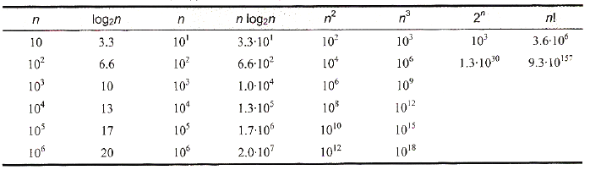
Analysis of Algorithms
Order of growth
Exponential-growth functions

Slide 9
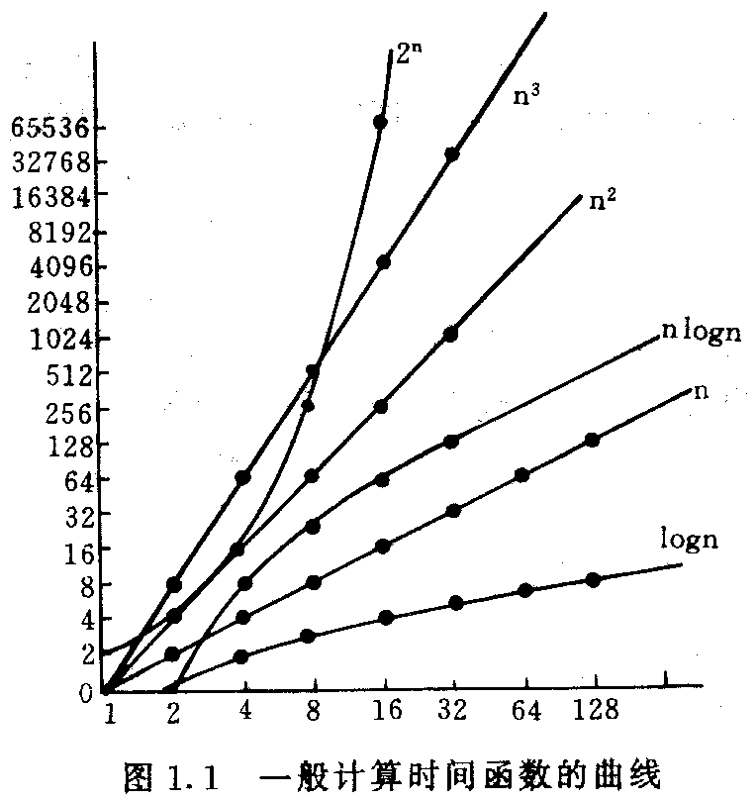
Analysis of Algorithms
Order of growth

Slide 10
Analysis of Algorithms
Basic Efficiency classes
The time efficiencies of a large number of algorithms fall into only a few classes.
fast
1 | constant
log n | logarithmic
n | linear
n log n | n log n
n² | quadratic
n³ | cubic
2^{n} | exponential
n! | factorial
High time efficiency
slow
low time efficiency
Notes:
一般认识
当数据集的规模很大时，要在现有的计算机系统上运行
具有比Ο(nlogn)复杂度还高的算法是比较困难的。
指数时间算法只有在n取值非常小时才实用。
要想在顺序处理机上扩大所处理问题的规模，有效的途径
是降低算法的计算复杂度，而不是（仅仅依靠）提高计算
机的速度。

Slide 11
Analysis of Algorithms
Worst-Case, Best-Case, and Average-Case Efficiency
For some algorithms efficiency depends on type of input.
  Example: Sequential Search
    Problem: Given a list of n elements and a search key K, find an element equal to K, if any.
    Algorithm: Scan the list and compare its successive elements with K until either a matching element is found (successful search) or the list is exhausted (unsuccessful search)
Given a sequential search problem of an input size of n,
what kind of input would make the running time the longest?
How many key comparisons?
Notes:
Cworst(n) = n, when there are no matching elements, or, the first matching element happens to be the last one on the list
worst case analysis – bounding the running time from above
Cbest (n) = 1

Slide 12
Analysis of Algorithms
  Example: Sequential Search
ALGORITHM SequentialSearch(A[0..n-1], K)
//Searches for a given value in a given array by sequential search
//Input: An array A[0..n-1] and a search key K
//Output: Returns the index of the first element of A that matches K or –1 if there are no matching elements
i ←0
while i < n and A[i]≠K do
i ← i + 1
if i < n //A[i] = K
return i
else
return -1

Slide 13
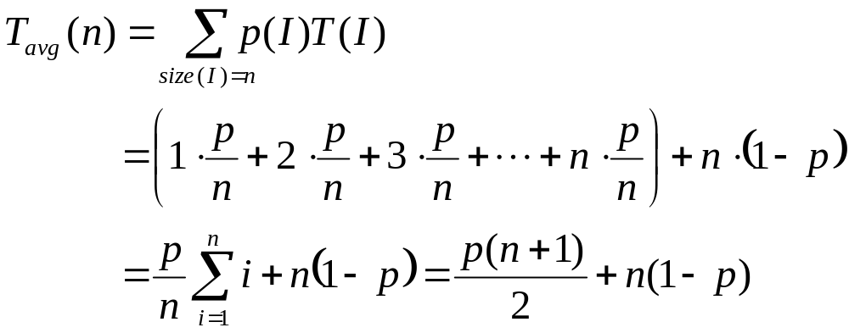
Analysis of Algorithms
  Example: Sequential Search
probability for successful search is p ( 0 ≤ p ≤ 1 )；
probability for successful search on each position i ( 0 ≤ i < n ) in an array is equal, p/n。
dividing all instances of size n into several classes so that for each instance of the class the number of times the basic operation is executed is the same;
a probability distribution of inputs is obtained or assumed
T worst (n)=n
T bset (n)=1
Notes:
I是问题的规模为n的实例，p(I)是实 例I出现的概率。

Slide 14
Analysis of Algorithms
Problem: impossible to calculate e_{i} for every legal input I
Solution: to calculate e_{i} for some representative input
Worst case Efficiency
  Efficiency (# of times the basic operation will be executed) for the worst case input of size n
  The algorithm runs the longest among all possible inputs of size n
  To see what kind of inputs yield the largest value of the basic operation’s count C(n) among all possible inputs of size n
  Bounding an algorithm’s efficiency from above
Notes:
（1）最坏情况下的时间复杂性
T_{max}(n) = max{ T(I) | size(I)=n }
（2）最好情况下的时间复杂性 does not mean the smallest input
T_{min}(n) = min{ T(I) | size(I)=n }
（3）平均情况下的时间复杂性
T_{avg}(n) =
其中I是问题的规模为n的实例，p(I)是实 例I出现的概率。
� 算法的最优、最差和平均效率
�最差效率是指在输入规模为n时，算法在最坏情况下的效率。
�最优效率是指在输入规模为n是，算法在最优情况下的效率。
�平均效率是指在“典型”或“随机”输入的情况下，算法具有的行为（效率）

Slide 15
Analysis of Algorithms
Best case
  Efficiency (# of times the basic operation will be executed) for the best case input of size n.
  The algorithm runs the fastest among all possible inputs of size n.
  To see what kind of inputs yield the smallest value of the basic operation’s count C(n) among all possible inputs of size n
  Bounding an algorithm’s efficiency from below
  If the best-case efficiency of an algorithm is unsatisfactory, we can immediately discard it.
Notes:
（1）最坏情况下的时间复杂性
T_{max}(n) = max{ T(I) | size(I)=n }
（2）最好情况下的时间复杂性 doesnot mean the smallest input
T_{min}(n) = min{ T(I) | size(I)=n }
（3）平均情况下的时间复杂性
T_{avg}(n) =
其中I是问题的规模为n的实例，p(I)是实 例I出现的概率。
� 算法的最优、最差和平均效率
�最差效率是指在输入规模为n时，算法在最坏情况下的效率。
�最优效率是指在输入规模为n是，算法在最优情况下的效率。
�平均效率是指在“典型”或“随机”输入的情况下，算法具有的行为（效率）

Slide 16
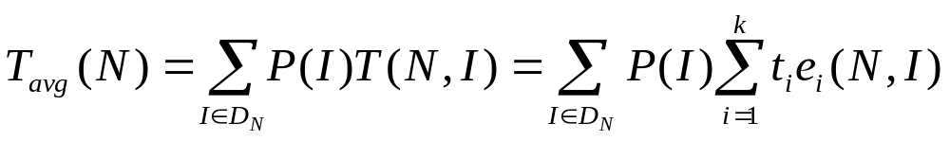
Analysis of Algorithms
Average case:
  Efficiency (#of times the basic operation will be executed) for a typical/random input of size n.
  NOT the average of worst and best case
  How to find the average case efficiency?
Tavg cannot be obtained by taking the average of Tworst and Tbest

Slide 17
Analysis of Algorithms
Summary of the Analysis Framework
Time efficiency is measured by counting the number of basic operations executed in the algorithm. The space efficiency is measured by the number of extra memory units consumed.
Both time and space efficiencies are measured as functions of input size.
The framework’s primary interest lies in the order of growth of the algorithm’s running time (space) as its input size goes infinity.
The efficiencies of some algorithms may differ significantly for inputs of the same size. For these algorithms, we need to distinguish between the worst-case, best-case and average case efficiencies.

Slide 18
Asymptotic notations
Asymptotic complexity
  If
  T(n) →∞ , as n→∞;
(T(n) - t(n) )/ T(n) →0 ，as n→∞;
Then, t(n) is called asymptotic state of T(n), n→∞
t(n) is called asymptotic complexity of algorithm A, n→∞
  Example:
  for T(n)=3n²+4nlogn+7, t(n)=3n²
  t(n) consider only the leading term of T(n)
  Ignore the constant coefficient
  Only consider the rank of t(n)
Notes:
算法渐近复杂性:
T(n) →∞ , as n→∞ ;
(T(n) - t(n) )/ T(n) →0 ，as n→∞;
t(n)是T(n)的渐近性态，为算法的渐近复杂性。
在数学上， t(n)是T(n)的渐近表达式，是T(n)略去低阶项留下的主项。它比T(n) 简单。

Slide 19
Asymptotic notations
Three notations used to compare orders of growth of an algorithm’s basic operation count
  O(g(n)): class of functions t(n) that grow no faster than g(n)
  Ω(g(n)): class of functions t(n) that grow at least as fast as g(n)
  Θ (g(n)): class of functions t(n) that grow at same rate as g(n)
Upper Bound
Lower Bound
The same rate
Notes:
t(n): an algorithm’s running time, usually indicated by its basic operation count C(n)
g(n): some simple function to compare the count with
算法效率的主要指标是基本操作次数的增长次数。
�为了对这些增长次数进行比较和归类，计算机科学家们使用了3种符号：
�O（读“O”）：上界
�Ω（读”omega”）：下界
�Θ（读”theta”）：近似

Slide 20
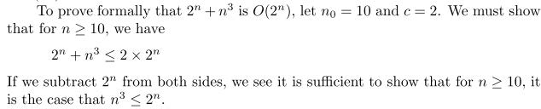

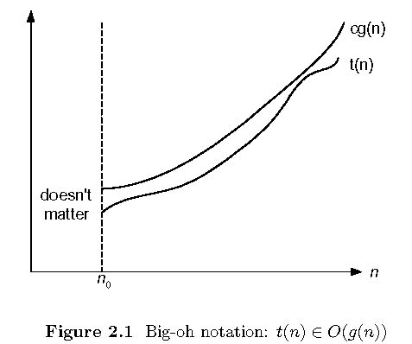
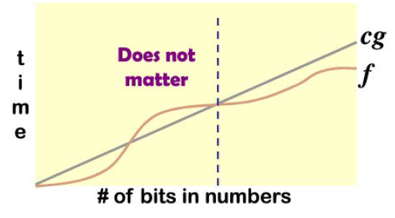
Asymptotic notations
O-notation
  Formal definition:
  A function t(n) is said to be in O(g(n)), denoted t(n) ∈ O(g(n)), if t(n) is bounded above by some constant multiple of g(n) for all large n, i.e., if there exist some positive constant c and some nonnegative integer n₀ such that
  E.g.:
  100n +5<=100n+n=101n<=101n²
  Example:
  10n² ∈ O(n²)
  10n² + 2n ∈ O(n²)
  100n + 5 ∈ O(n²)
  5n+20 ∈ O(n)
Notes:
渐近上界:
对于足够大的n，t(n)的上界由g(n)的常数倍来确定
当规模充分大时的一个上界，这个上界的阶越低，则评估就越精确

Slide 21

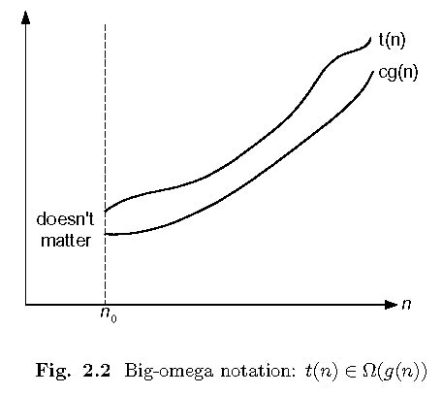
Asymptotic notations
Ω-notation
  Formal definition:
  A function t(n) is said to be in Ω(g(n)), denoted t(n) ∈ Ω(g(n)), if t(n) is bounded below by some constant multiple of g(n) for all large n, i.e., if there exist some positive constant c and some nonnegative integer n₀ such that
  Example:
  10n² ∈ Ω(n²)
  10n² + 2n ∈ Ω(n²)
  10n³ ∈ Ω(n²)
Notes:
对于足够大的n，t(n)的下界由g(n)的常数倍来确定，
这个下界的阶越高，则评估就越精确

Slide 22
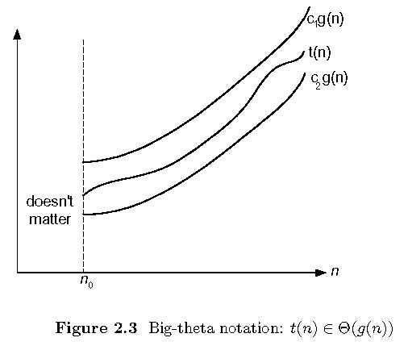
Asymptotic notations
Θ-notation
  Formal definition:
  A function t(n) is said to be in Θ(g(n)), denoted t(n) ∈ Θ(g(n)), if t(n) is bounded both above and below by some positive constant multiples of g(n) for all large n, i.e., if there exist some positive constant c₁ and c₂ and some nonnegative integer n₀ such that
  Example:
  10n² ∈ Θ(n²)
  an² + bn +c∈ Θ(n²) with a>0
  (1/2)n(n-1) ∈ Θ(n²)
  n² +log n ∈ Θ(n²)
Θ (g(n)) = O (g(n)) ∩ Ω (g(n))
Notes:
紧渐近界:
对于足够大的n，t(n)的上界和下界由g(n)的常数倍来确定
t(n)与g(n)同阶

Slide 23


Asymptotic notations
Other notations
  o(g(n)):
  A function t(n) is said to be in o(g(n)), denoted t(n) ∈ o(g(n)), if t(n) is bounded above by some positive constant multiples of g(n) for all large n, i.e., if there exist some positive constant c and some nonnegative integer n0 such that
  ω(g(n)):
  A function t(n) is said to be in ω (g(n)), denoted t(n) ∈ ω(g(n)), if t(n) is bounded below by some positive constant multiples of g(n) for all large n, i.e., if there exist some positive constant c and some nonnegative integer n0 such that

Slide 24
Asymptotic notations
>=
higher or same order of growth
Ω(g(n)), functions that grow at least as fast as g(n)
=
Θ(g(n)), functions that grow at the same rate as g(n)
g(n)
<=
smaller or same order of growth
O(g(n)), functions that grow no faster than g(n)

Slide 25
Asymptotic notations
Some Properties of Asymptotic Order of Growth
  f(n) ∈ O(f(n)) 反身性
  f(n) ∈ O(g(n)), g(n) ∈ O(h(n)) ⇒ f(n) ∈ O(h(n))；传递性
  f(n) ∈ O(g(n)) ⇔ g(n) ∈Ω(f(n)) 互对称性
  f(n) ∈ Θ(g(n)) ⇔ g(n) ∈ Θ (f(n)) 对称性
  O(g₁(n))+O(g₂(n)) = O(g₁(n)+g₂(n)) ； 数学计算
  O(g₁(n))*O(g₂(n)) = O(g₁(n)*g₂ (n)) ；
  O(cf(n)) = O(f(n)) ；
  g(n)= O(f(n)) ⇒ O(f(n))+O(g(n)) = O(f(n))
The analogous assertions are true for the Ω-notation and Θ-notation.

Slide 26
Asymptotic notations
Some Properties of Asymptotic Order of Growth
  If t₁(n) ∈ O(g₁(n)) and t₂(n) ∈ O(g₂(n)) , then
  t₁(n) + t₂(n) ∈ O(max{g₁(n), g₂(n)})
  Implication:
  For an algorithm that comprises two consecutively executed parts,
  The algorithm’s overall efficiency will be determined by the part with a larger order of growth.
  Example:
    5n² + 3nlogn ∈ O(n²)
    check whether an array has identical elements:
    first, sort the array by some sorting alg.,
    ——no more than (1/2)n(n-1) comparisons
    then, scan the sorted array to check its consecutive elements for equality
    ——no more than (n-1) comparisons
Notes:
当算法由两个连续执行部分组成时，该算法的整体效率由具有较大增长次数的那部分所决定。

Slide 27
Asymptotic notations
Using Limits for Comparing Orders of Growth
0 order of growth of T(n) < order of growth of g(n)
lim_{n→∞} T(n)/g(n) =
c>0 order of growth of T(n) = order of growth of g(n)
∞ order of growth of T(n) > order of growth of g(n)
case 1 & 2， T(n) ∈ O(g(n)); case 3 & 2， T(n) ∈ Ω(g(n));
case 2， T(n) ∈ Θ(g(n));
  Example:
    5n² + 3nlogn ∈ O(n²)
10n vs. 2n²
n(n+1)/2 vs. n²
log_{b} n vs. log_{c} n

Slide 28
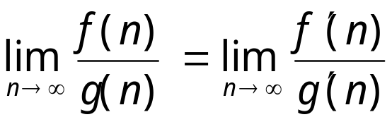
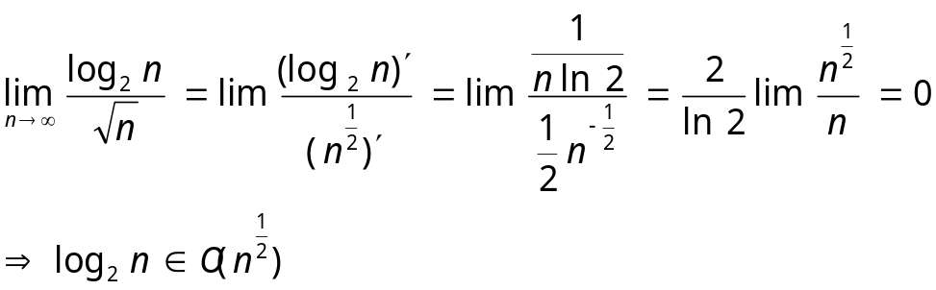
Asymptotic notations
L’Hôpital’s rule
  If lim_{n→∞} f(n) = lim_{n→∞} g(n) = ∞ and the derivatives f ´, g ´ exist, Then
  Example:
    (1/2)n(n-1) ∈ Θ(n²)
    log₂n ∈ O(n^{1/2})
    log₂n vs. n
    2^{n} vs. n!

Slide 29
Asymptotic notations
Orders of growth by some important functions
  All logarithmic functions log_{a}n belong to the same class Θ(log n) no matter what the logarithm’s base a > 1 is.
  All polynomials of the same degree k belong to the same class: a_{k}n^{k} + a_{k-1}n^{k-1} + … + a₀ ∈ Θ(n^{k}).
  Exponential functions a^{n} have different orders of growth for different a’s.
  Order log n < order n^{α} (α>0) < order a^{n} < order n! < order n^{n}

Slide 30
Asymptotic notations
Summary of How to Establish Orders of Growth of an Algorithm’s Basic Operation Count
  Method 1: Using limits
  L’Hôpital’s rule
  Method 2: Using the properties
  Method 3: Using the definitions of O-, Ω-, and Θ-notation.
  The time efficiencies of a large number of algorithms fall into a few classes, as see in the list.

Slide 31
Time Efficiency of Non-recursive Algorithms
Steps in mathematical analysis of nonrecursive algorithms:
Decide on parameter n indicating input size
Identify algorithm’s basic operation
Check whether the number of times the basic operation is executed depends only on the input size n. If it also depends on the type of input, investigate worst, average, and best case efficiency separately.
Set up summation for C(n) reflecting the number of times the algorithm’s basic operation is executed.
Simplify summation to find a closed-form formula or, at the very least, find its order of growth, using standard formulas (see Appendix A)
Notes:
分析非递归算法效率的通用方案:
1. 决定用那些参数作为输入规模的度量。
2. 找出算法的基本操作。
3. 检查基本操作的执行次数是否只依赖输入规模。
4. 建立一个算法基本操作执行次数的求和表达式。
5. 利用求和运算的标准公式和法则来建立一个操作次数的闭合公式，或者至少确定它
的增长次数

Slide 32
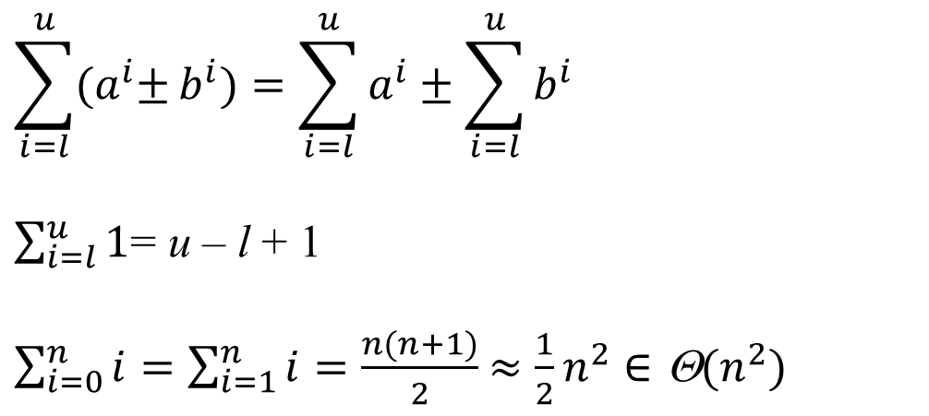
Time Efficiency of Non-recursive Algorithms
Useful basic rules and standard formulas for sum manipulation

Slide 33
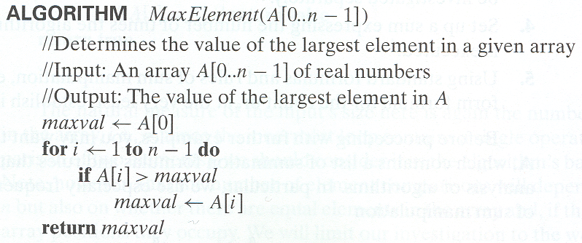
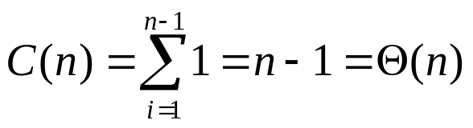
Time Efficiency of Non-recursive Algorithms
Example 1: Maximum element
Basic operation: comparison (in the for loop, and executed on each repetition)
Input size: array length n
time efficiency :
Notes:
从n个元素中查找最大元素问题
算法 MaxElement(A[0..n-1]
//求给定数组中的最大元素
//输入：实数数组A[0..n-1]
//输出：A中的最大元素
maxval �A[0]
for i � 1 to n-1 do
if A[i] > maxval
maxval � A[i]
return maxval
考虑：
循环中的操作有比较和赋值，取哪一个作为基本操作？
输入规模是多少？
基本操作为：比较运算
输入规模就是数组长度n

Slide 34
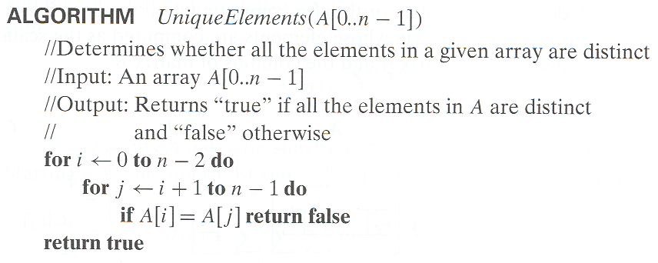
Time Efficiency of Non-recursive Algorithms
Example 2: Element uniqueness problem
Basic operation: comparison
Input size: array length n
Time complexity
Notes:
Example 2 元素唯一性问题
算法 UniqueElements(A[0..n-1])
//验证给定数组的元素是否全部唯一
//输入：实数数组A[0..n-1]
//输出：如果唯一，返回True，否则False
for i�0 to n-2 do
for j�i+1 to n-1 do
if A[i]=A[j] return False
return True
---------------------------------------------
先排序（许多排序算法），一般排序算法(如快速排序、堆排序、归并排序)时间复杂度都为nlog(n)，
再比较两相邻数即可,复杂度为n,
o(n) + o(nlog(n)) = o(nlog(n)) 即时间复杂度为 o(nlog(n))

Slide 35
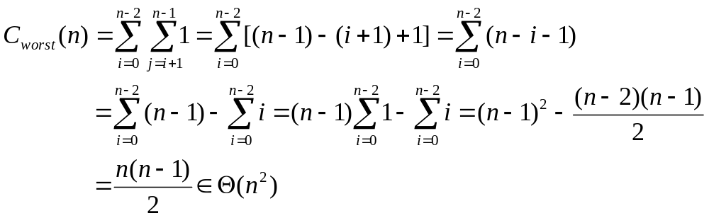
Time Efficiency of Non-recursive Algorithms
The number of element comparison depends on
array size n
whether there are equal elements in the array and, if there are, which array positions they occupy
Worst case
arrays with no equal elements
arrays in which the last two elements are the only pair of equal ones

Slide 36
Time Efficiency of Non-recursive Algorithms
Another algorithm for Element uniqueness problem
First, sort the array by some sorting alg.,
—— time complexity for quick-sort alg. is Θ (n log n)
Then, scan the sorted array to check its consecutive elements for equality
——no more than (n-1) comparisons
So, the total time complexity is Θ (n log n)

Slide 37
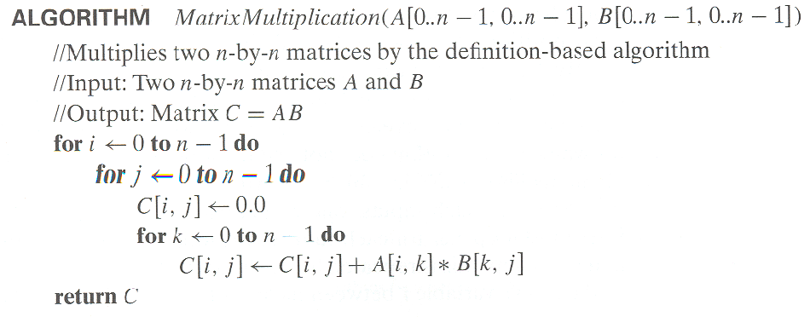
Time Efficiency of Non-recursive Algorithms
Example 3: Matrix multiplication
Basic operation: multiplication
Input size: matrix order n
The complexity of square matrix multiplication, carried out by definition-based algorithm, is O(n³),
to compute n² elements of the product matrix,
dot product of n-element row of matrixA and n-element column of matrix B
C(n) = n *n²
Notes:
算法 MatrixMuti(A[0..n-1,0..n-1],B[0..n-1,0..n-1])
//根据定义计算两个n阶矩阵的乘积
//输入：两个n阶矩阵
//输出：矩阵C=AB

Slide 38
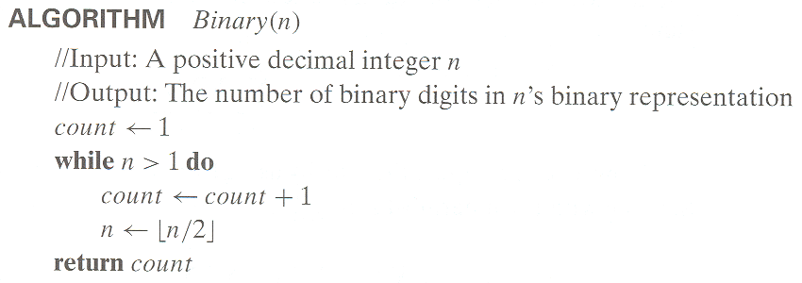
Time Efficiency of Non-recursive Algorithms
Example 4: Counting binary digits
The loop’s variable changes in a different manner , it cannot be investigated by the way the previous examples are.
about log₂ n
Notes:
----------------------------------------------------
问题的计算时间下界为Ω(f(n))，则计算时间复杂性为O(f(n))的算法是最优算法。
例如，排序问题的计算时间下界为Ω(nlogn)，计算时间复杂性为O(nlogn)的排序算法是最优算法。
堆排序算法是最优算法。

Slide 39
Mathematical Analysis of Recursive Algorithms
Steps in Mathematical Analysis of Recursive Algorithms
Decide on parameter n indicating input size
Identify algorithm’s basic operation
Check whether the number of times the basic operation is executed may vary on different inputs of the same size. (If it may, the worst, average, and best cases must be investigated separately.)
Set up a recurrence relation and initial condition(s) for C(n)-the number of times the basic operation is executed for an input of size n (alternatively count recursive calls).
Solve the recurrence or estimate the order of growth of the solution by backward substitutions or some other method
Notes:
递归的概念：
直接或间接地调用自身的算法称为递归算法。用函数自身给出定义的函数称为递归函数。
边界条件与递归方程是递归函数的二个要素
--------------------------------------------------------
� 决定用哪个参数作为输入规模的度量
�找出算法的基本操作
�检查对相同规模的输入，基本操作的执行次数是否相同，如果不同，必须对最差、
平均及最优效率单独研究
�建立一个递推关系式及相应的初始条件
�求解这个递归关系式，或者至少确定解的增长次数

Slide 40

Mathematical Analysis of Recursive Algorithms
Example 1: Recursive evaluation of n !
Definition
  Iterative Definition
  F(n) = 1 if n = 0
  = n * (n-1) * (n-2)… 3 * 2 * 1 if n > 0
  Recursive definition
  F(n) = 1 if n = 0
  F(n) = n * F(n-1) if n > 0
Succinctness vs. efficiency
Be careful with recursive algorithms because their succinctness mask their inefficiency.
Notes:
我们应该谨慎使用递归算法，因为他们的简洁可能会掩盖他们的低效率。

Slide 41
Mathematical Analysis of Recursive Algorithms
Example 1: Recursive evaluation of n ! (‘cont)
Algorithm F(n)
  if n=0
  return 1 //base case
  else
    return F (n -1) * n //general case

Slide 42
Mathematical Analysis of Recursive Algorithms
Example 1: Recursive evaluation of n ! (‘cont)
to solve recurrences,
method of backward substitutions
C(n)= C(n-1)+1
= [C(n-2)+1]+1 =C(n-2)+2
= [C(n-3)+1]+2 =C(n-3)+3
= …… = C(n-i) + i = ……
= [C(n-n)+1]+n-1 = n
input size: n
basic operation: multiplication
Times of Basic operation for F(n)
C(0)= 0
C(n)= C(n-1)+1
initial condition
recurrence relation
to find the initial condition, to see when the call stop in the pseudocode

Slide 43
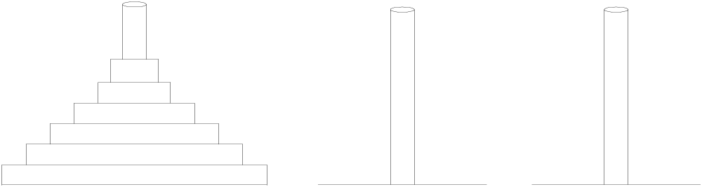
Mathematical Analysis of Recursive Algorithms
Example 2: The Tower of Hanoi Puzzle
a b c
1
3
2
Notes:
设a,b,c是3个塔座。开始时，在塔座a上有一叠共n个圆盘，这些圆盘自下而上，由大到小地叠在一起。各圆盘从小到大编号为1,2,…,n,现要求将塔座a上的这一叠圆盘移到塔座b上，并仍按同样顺序叠置。在移动圆盘时应遵守以下移动规则：
规则1：每次只能移动1个圆盘；
规则2：任何时刻都不允许将较大的圆盘压在较小的圆盘之上；
规则3：在满足移动规则1和2的前提下，可将圆盘移至a,b,c中任一塔座上。

Slide 44
Mathematical Analysis of Recursive Algorithms
Example 2: The Tower of Hanoi Puzzle (‘cont)
Algorithm hanoi(int n, int a, int b, int c)
// Put n plates from tower a to tower b through tower c
{
if (n > 0)
{
hanoi(n-1, a, c, b); // n-1个较小圆盘从塔座a移到c
move(a,b);
hanoi(n-1, c, b, a);
}
}

Slide 45
Mathematical Analysis of Recursive Algorithms
Example 2: The Tower of Hanoi Puzzle (‘cont)
Recurrence Relations
input size: the number of disks, n
basic operation: moving one disk
total number of moving : C(n)
  C(1) = 1
  C(n) = 2C(n – 1) + 1 =2^{n}-1 for every n >1
  C(n) ∈ Θ (2^{n})
C(n) = 2C(n – 1) + 1
= 2(2C(n-2)+1)+1 = 2²C(n-2)+2+1=...
= 2^{i}C(n-i)+2^{i-1}+2^{i-2} +...+2+1 =...
= 2^{n-1}C(1)+2^{n-2}+2^{n}-3+...+2+1
= 2^{n-1}+2^{n-2}+2^{n-3}+...+2+1 等比数列
＝(1-q^{n})/(1-q) = (2^{n}-1)/(2-1) = 2^{n}-1

Slide 46
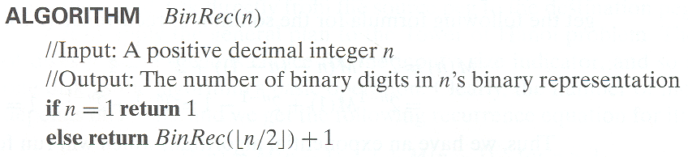
Mathematical Analysis of Recursive Algorithms
Example 3: Find the number of binary digits in the binary representation of a positive decimal integer
number of additions: in computing BinRec
A(n) = A(⎣n/2⎦)+1 with A(1) = 0

Slide 47
Mathematical Analysis of Recursive Algorithms
Example 3: (‘cont)
Smoothness Rule:
let T(n) be an eventually non-decreasing function and f(n) be a smooth function. If
T(n) ∈ Θ (f(n)) for values of n that are powers of b,
where b>=2, then
T(n) ∈ Θ (f(n)) for any n.
Under very broad assumptions, the order of growth observed for n=2^{k}, gives a correct answer about the order of growth for all values of n.

Slide 48
Mathematical Analysis of Recursive Algorithms
Example 3: (‘cont)
Proof by Smoothness Rule
for n =2^{k},
A(2^{k}) = A(2^{k-1}) +1 for k>0
A(2⁰) = 0
backward substitutions:
A(2^{k}) = A(2^{k-1}) +1
= [A(2^{k-2}) +1] + 1 = A(2^{k-2}) +2
= [A(2^{k-3}) +1] + 2 = A(2^{k-3}) +3 ......
= A(2^{k-i}) +i ......
= A(2^{k-k}) +k
= A(2⁰) +k = A(1) +k = k
then, A(n) = log₂n = Θ (logn)

Slide 49
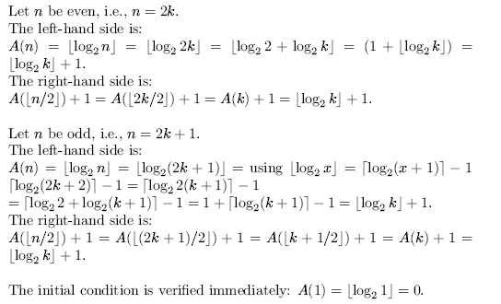
Mathematical Analysis of Recursive Algorithms
For example3 BinRec
A(n) = A(⎣n/2⎦)+1 with A(1) = 0 → A(n) ∈ Θ (log n)
In fact, we can prove A(n) = ⎣ log n ⎦ is the solution to above recurrence.
Proof by Mathematical Induction

Slide 50
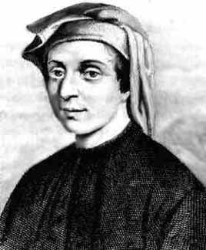
Mathematical Analysis of Recursive Algorithms
Fibonacci numbers
The Fibonacci numbers:
0, 1, 1, 2, 3, 5, 8, 13, 21, …
The Fibonacci recurrence:
The nth Fibonacci number :
F(n) = F(n-1) + F(n-2)
F(0) = 0
F(1) = 1
Notes:
斐波那契数列

Slide 51
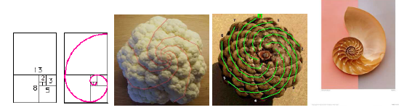
Mathematical Analysis of Recursive Algorithms
applications
斐波那契螺旋：使所有种子具有差不多的大小却又疏密得当，不至于在圆心处挤了太多的种子而在圆周处却又稀稀拉拉。
叶子的生长方式也是如此。

Slide 52
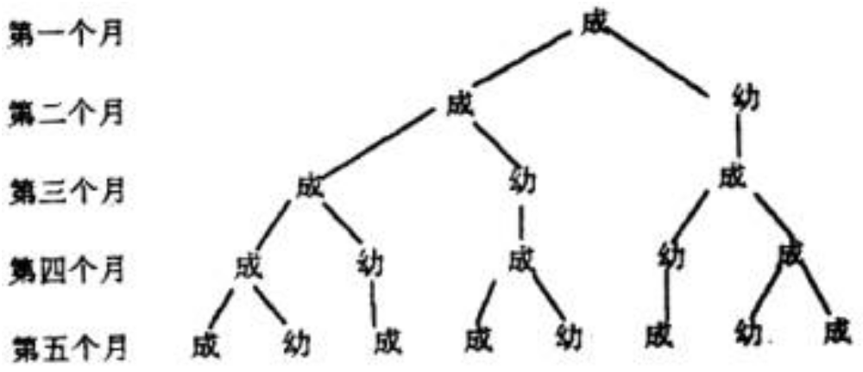
Mathematical Analysis of Recursive Algorithms
兔子问题

Slide 53
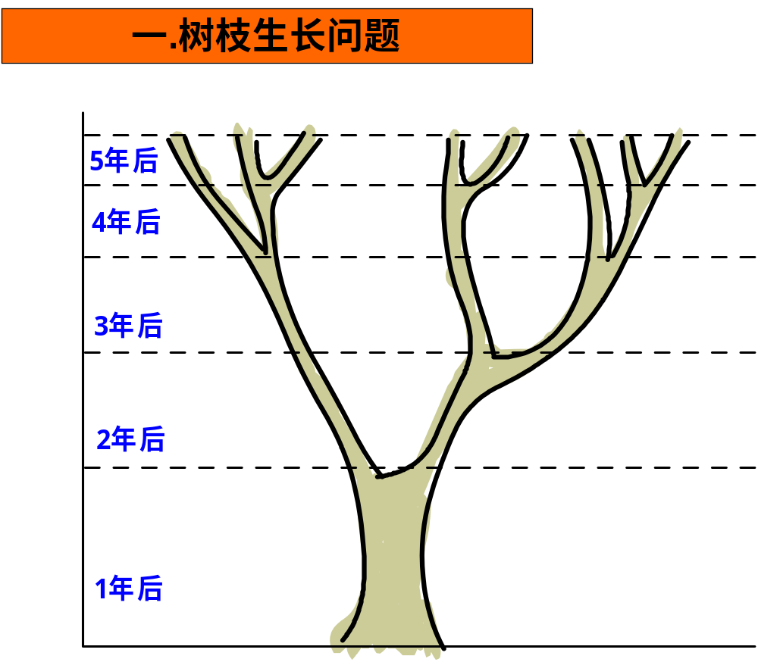
Mathematical Analysis of Recursive Algorithms
树枝生长问题
一株树苗在一段间隔，例如一年，以后长出一条新枝；第二年新枝“休息”，老枝依旧萌发；此后，老枝与“休息”过一年的枝同时萌发，当年生的新枝则次年“休息”。这样，一株树木各个年份的枝桠数，便构成斐波那契数列。这个规律，就是生物学上著名的“鲁德维格定律”。

Slide 54
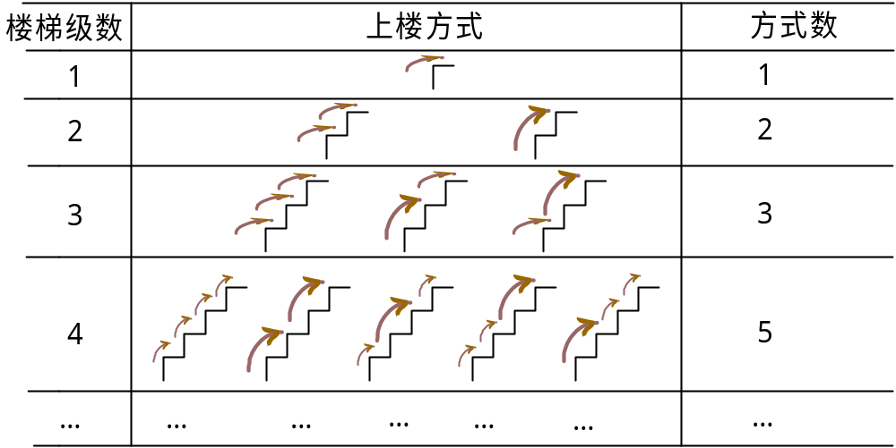
Mathematical Analysis of Recursive Algorithms
上楼梯问题：楼梯时，若允许每次跨一级或两级，那么对于楼梯数为1，2，3，4时上楼的方式数各是多少
Notes:
斐波那契数列

Slide 55
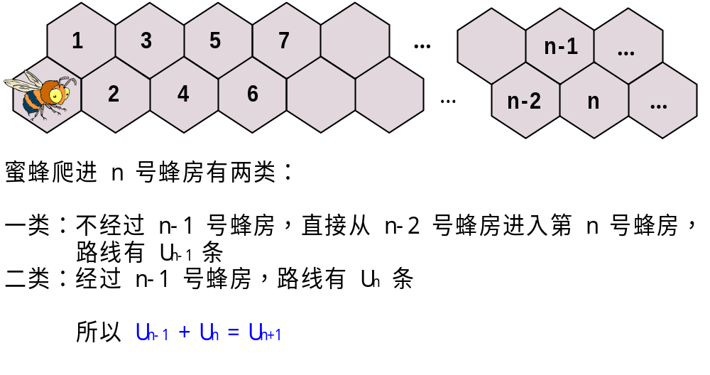
Mathematical Analysis of Recursive Algorithms
蜜蜂进蜂房问题：一次蜜蜂从蜂房A出发，想爬到1、2、……、n号蜂房，只允许它自左向右（不许反方向倒走）。则它爬到各号蜂房的路线多少？
蜜蜂爬进n号蜂房有两种途径：
不经过n -1号，直接从n -2号进入n号蜂房，这种路线有u_{n-2}种
经过n -1号，进入n号蜂房，这种路线有u_{n-1}种，
故： u_{n}＝ u_{n-1} + u_{n-2}

Slide 56
Summary
算法的效率包括时间效率与空间效率
时间效率用输入规模的函数来度量，该函数的计算主要关注算法基本操作的执行次数
增长阶数 Order of growth
Worst-Case, Best-Case, and Average-Case Efficiency
O-notation, Θ-notation, Ω-notation
递归与非递归算法的效率分析
Notes:
教学内容
�算法效率分析框架
�算法效率的渐进性表示
�非递归算法的效率分析
�递归算法的效率分析

Slide 57
思考题
2-1. Consider the definition-based algorithm for adding two n-by-n matrices.
What is its basic operation?
How many times is it performed as a function of the matrix order n?
How many times is it performed as a function of the total number of elements in the input matrices?
2-2. For each of the following algorithms, indicate i) a natural size metric for its inputs; ii) its basic operation; iii) whether the basic operation count can be different for inputs of the same size.
computing a!
computing the sum of n numbers

Slide 58
思考题
2-3. Indicate whether the first function of each of the following pairs has a smaller, same, or large order of growth than the second function.
n(n+1) and 2000n²
(n-1)! and n!
2^{n-1} and 2^{n}
2-4. Use the informal definitons of O, Ω and Θ to determine whether the following assertions are true or false.
n(n+1)/2 ∈ O(n³)
n(n+1)/2 ∈ Θ(n²)

Slide 59
思考题
2-5 习题2.3的4 5 6 10

